Slide 1

Punctuation
Department of English
Kanya Mahavidyalaya Kharkhoda
Sonepat Haryana

Slide 2
Introduction
There was no punctuation in any languages of ancient times. With the advancement of civilization, punctuation was introduced in the written form of the language to help a reader distinguish words and ideas from each other and to mirror the natural rhythms of the spoken language.

Slide 3
Definition of Punctuation
Punctuation is a set of marks that regulates and clarifies the meanings of different texts. The term “punctuation” has originated from the Medieval Latin word “pūnctuātiōn,” which means markings or signs.

Slide 4
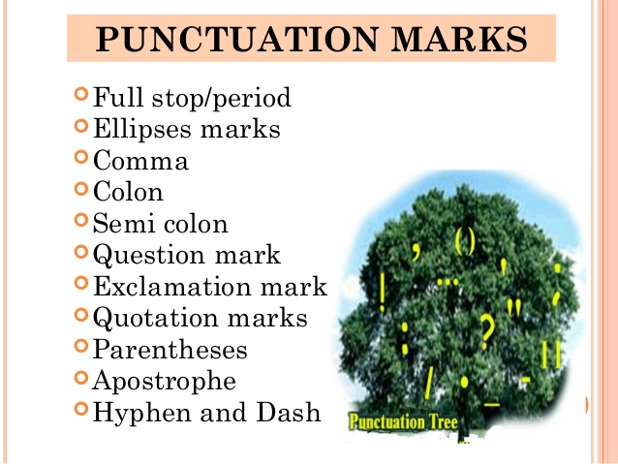
Types of Punctuation

Slide 5
Period (.)
The period is also called full stop in England. A period declares the end of a sentence. It also indicates the separation of sentences so that the readers cannot mix up different sentences. A period is used at the end of a sentence which is complete and not a question or an exclamatory sentence.
Example:
Alex was a little boy when he first saw a person dying. He was so shocked and panicked that he could not sleep for several days. He still fears the sight of someone’s death.
The period is also used in abbreviations.
Example:
Saint = St.
Exempli gratia = e.g.
Nota bene = N.B.

Slide 6
Note of Interrogation (Question Mark) (?)
The note of interrogation is used to complete sentences that form a direct question. Indirect questions are regarded as statements, and they take periods, not question marks.
Example:
Have you had your breakfast?
Where are you going?
I don’t know where he is going. (A statement, not a direct question)

Slide 7
Note of Exclamation (Exclamation mark/point) (!)
The note of exclamation indicates excitement, either positive or negative. It can also be used for giving additional emphasis to sentences, phrases, or single words, and especially to commands and interjections.
Example:
Wait! Don’t take another step!
I can’t believe she could say that!
What a gorgeous house!
Note: It is best to avoid using a note of exclamation whenever the excitement can be described in words. You should be meticulous in using this punctuation in any form of writing.

Slide 8
Comma (,)
The comma is the most useful and common punctuation mark in English. It has many important roles in making a written form of EnglExample:
They finished dinner in pin-drop silence, but Alex knew that he would have to apologize.
I wanted to watch a movie after dinner, but I could not tell her as I was confused about her reactions.

Slide 9
Colon (:)
Colons are the least used punctuation mark. The usage of colons is limited. Yet, if you know how to use them, you will be able to use them in your writing.
i. Colons are used in the salutations of formal letters.
Example:
Dear Sir:
To whom it may concern:
To all members:

Slide 10
Semicolon (;)
Semicolons are almost like periods, but they connect two independent clauses or sentences together instead of using a coordinating conjunction. Semicolons between the two clauses or sentences indicate that the clauses are closely related. Semicolons can be replaced by the coordinating conjunctions.
Example: We do not need a car now; we want to sell it. (This semicolon could be replaced by ‘and’.

Slide 11
Hyphen (-)
Hyphens combine words together to make Compound Nouns/Adjectives. Hyphens are also used with some suffixes and prefixes, such as -like, -wise, anti-, and post- to make new adjectives.
Example:
Anti-violent
Dog-like
Ability-wise
Decision-making
City-owned

Slide 12
Dash (–)
A dash hints a brief break in thought or helps to add information to a sentence. A dash has no space before or after it.
Example:
The man was running around the building—I couldn’t see his face—and disappeared down the alley.
This house—and every house on the street—will be connected by this wire.
Russel Crow—you know him, I think—is coming to our locality.

Slide 13
Apostrophe (’)
An apostrophe indicates possession and the exclusion of letters in contractions.
Example:
They’re going to Canada.
I’m not going.
Robert’s watch
Someone's glasses

Slide 14
Quotation Marks (‘...’/“... ... ..”)
Quotation marks are used for enclosing direct quotations of written or spoken words of others, or dialog said by characters in fiction.
They are also called quote marks or just quotes for short. The first of the pair is the opening or open quote. It curves to the right: “ ‘. The second one is the closing or close quote. It curves to the left: ’ ”.
Example:
Have you seen the music video for the song “Despacito”?
“Play with aggression” shouted the coach.
Your exact words were “get out of my room.”

Slide 15
Parentheses - ()
Parentheses block off materials that interrupt the text to add information.
Example:
The parks (in Boston) are always crowded.
We provide a lot of services. (See our website)
We provide a lot of services (see our website).

Slide 16
Brackets
Brackets enclose the additional things in the quoted material. These additions are used for clarifications of the words or phrases of the quoted materials.
Example:
“It [the river] taught me all I ever knew about life.”
“Yeats used to love her [Maude Gonne], and he wrote many poems about her.”
“Every man[sic] must die one day.”

Slide 17


